Slide 1
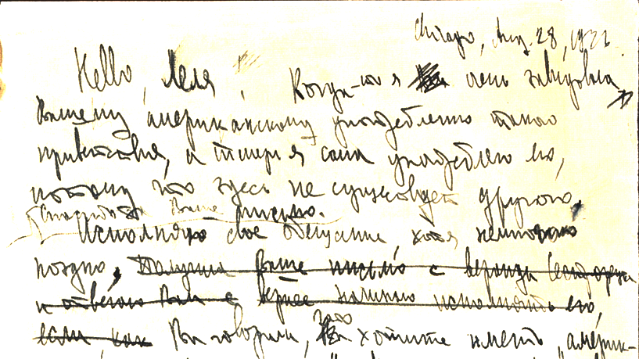

A (Virtual) Visit to
the Ayn Rand Archives

Slide 2
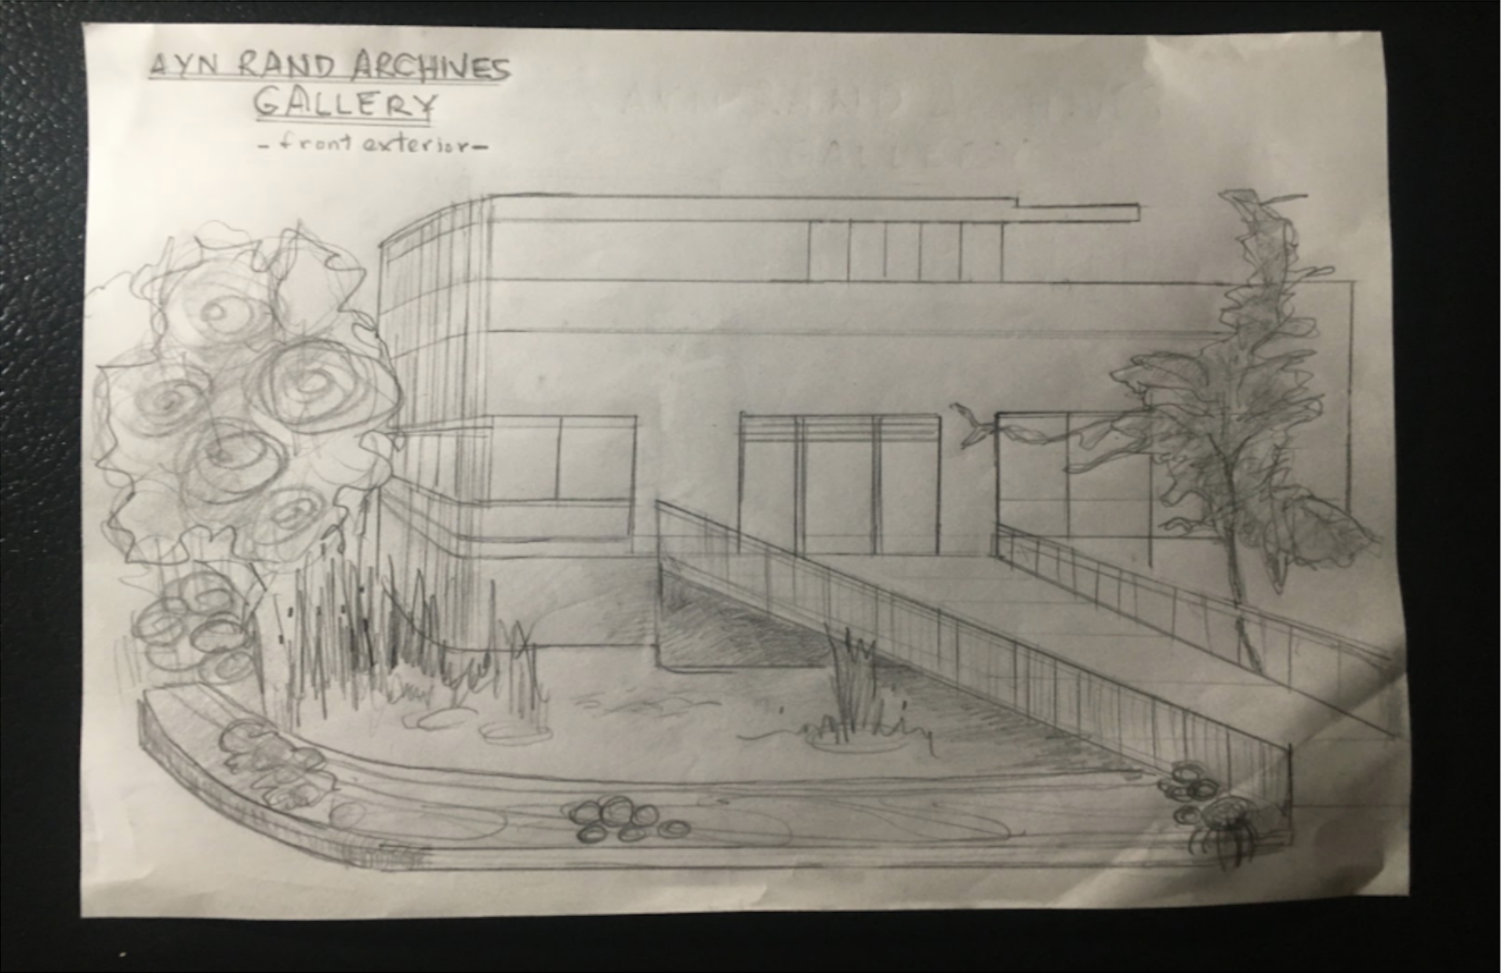
FRANK O’CONNOR GALLERY AND GARDEN

Slide 3
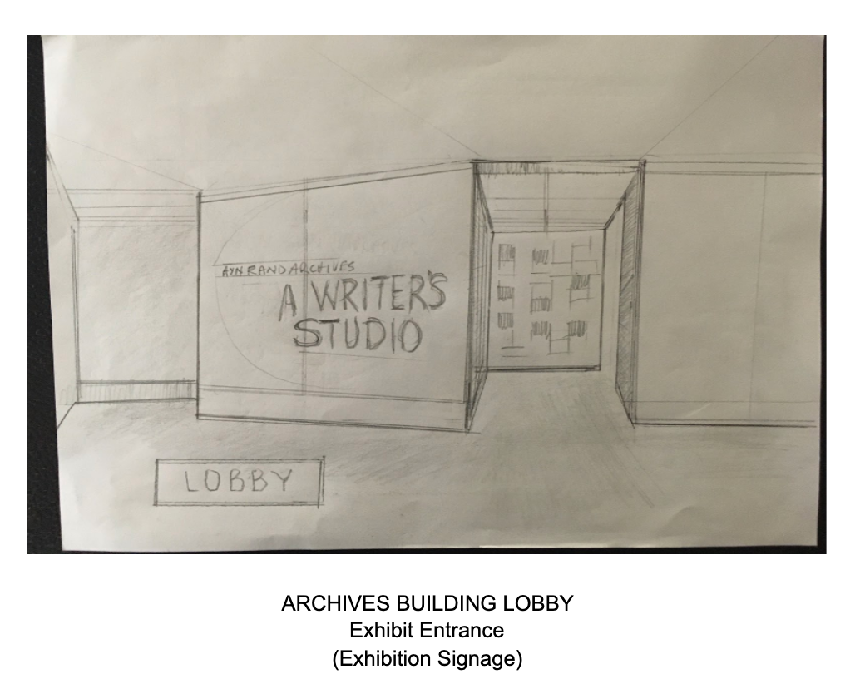
FRANK O’CONNOR GALLERY LOBBY

Slide 4
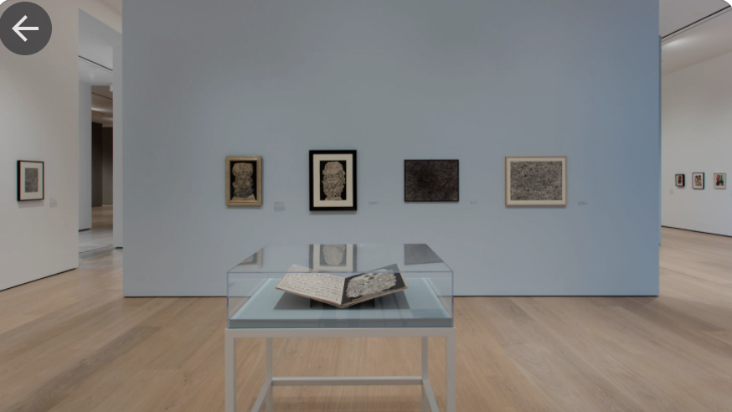
Archives Building: Lobby Colors
Floor and lobby wall: very light blue and off-white, blonde floor
(Disregard framed objects and exhibit cases)

Slide 5
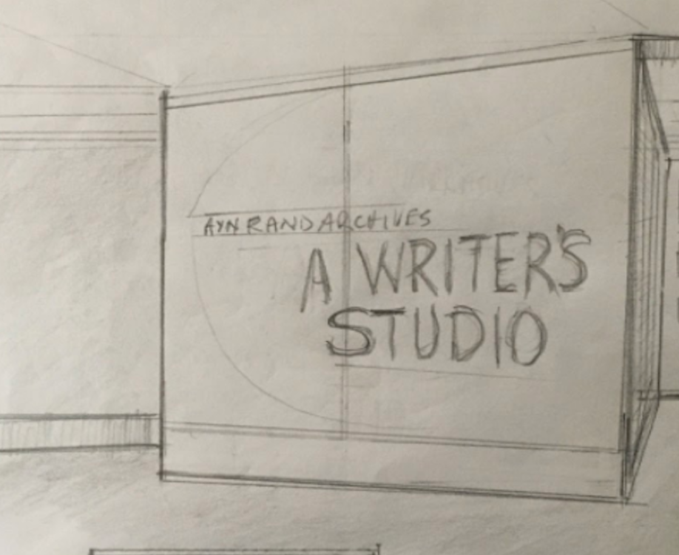
1.1. Facility Name / Exhibit Title / Gallery Name
Ayn Rand Archives / A Writer’s Studio / Frank O’Connor Gallery (display lower left below exhibit title)

Slide 6
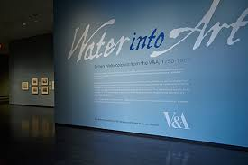
1.1. Facility Name / Exhibit Title / Gallery Name: Colors
Vinyl lettering: facility (white); exhibit (peacock blue); gallery named(white); medium blue background

Slide 7
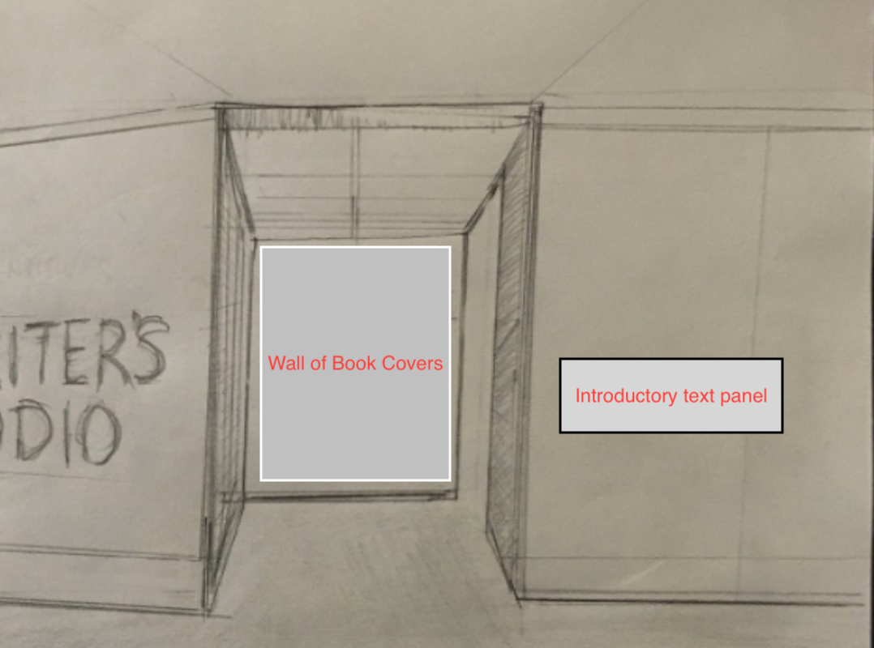
Exhibit Entrance
Introductory Text Panel and Wall of Book Covers

Slide 8
1.2 Introductory Text Panel, Lobby
[black lettering on off-white, floating panel]
Introductory Statement
Ayn Rand (1905 - 82) was a 20th century Russian-American novelist who published four novels that have developed a worldwide audience. As a novelist-philosopher, her Romantic Realist works and original philosophical system, Objectivism, are known and discussed. And today there is increasing interest in the physical circumstances in which she produced these works: her “writer studio.”
Ayn Rand wrote her four novels, as well as other fiction and nonfiction on a desk purchased for her in Los Angeles in 1929 by her husband, Frank O’Connor. The desk occupied more than a dozen apartments and a house in two cities, Los Angeles and New York between 1929 and 1982. On this desk she wrote her four novels plus other fiction and nonfiction works.
As a literary artist, Ayn Rand considered herself a Romantic Realist. She believed that art should depict what is metaphysically important in life. In her paraphrase of Aristotle's Poetics, art is concerned not with human history, reported journalistically, but human life recreated and portrayed as it could be and ought to be. This was Ayn Rand’s portal into the field of art.
A Writer’s Studio examines Rand’s art and the physical circumstances of her life while she was creating it. The exhibit incorporates artifacts from the Ayn Rand Archives, including ones selected from her personal papers and effects. These objects concretize her youthful decision to leave Soviet Russia and to establish herself in America in order to achieve “what ought to be” in art and in her life.

Slide 9
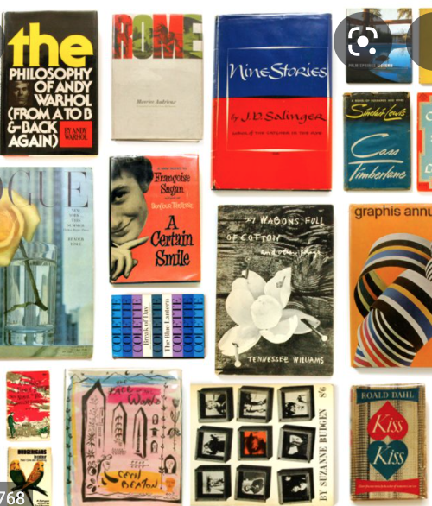
1.3.1 Wall of Books (end of entrance hallway)
Asymmetrical arrangement of repeated covers; bleed to edge; floating on light blue background

Slide 10
1.3.2 Wall of Books, Text Panel
[black lettering on off-white, floating panel, attached to hallway wall left]
Four Novels
Early in her writing career, Ayn Rand’s publishers assumed the responsibility for designing book covers. However, by the 1970s, Rand’s reputation was well established; and she was able to participate in the art direction of a series of new covers for her fiction and nonfiction works. These later covers, incorporating original paintings into fields of white, were executed by painter, Robert Heindel, an contemporary artist whose depictions of ballet dancers, athletes and scientists, aligned with Rand’s view of the ideal human figure.

Slide 11
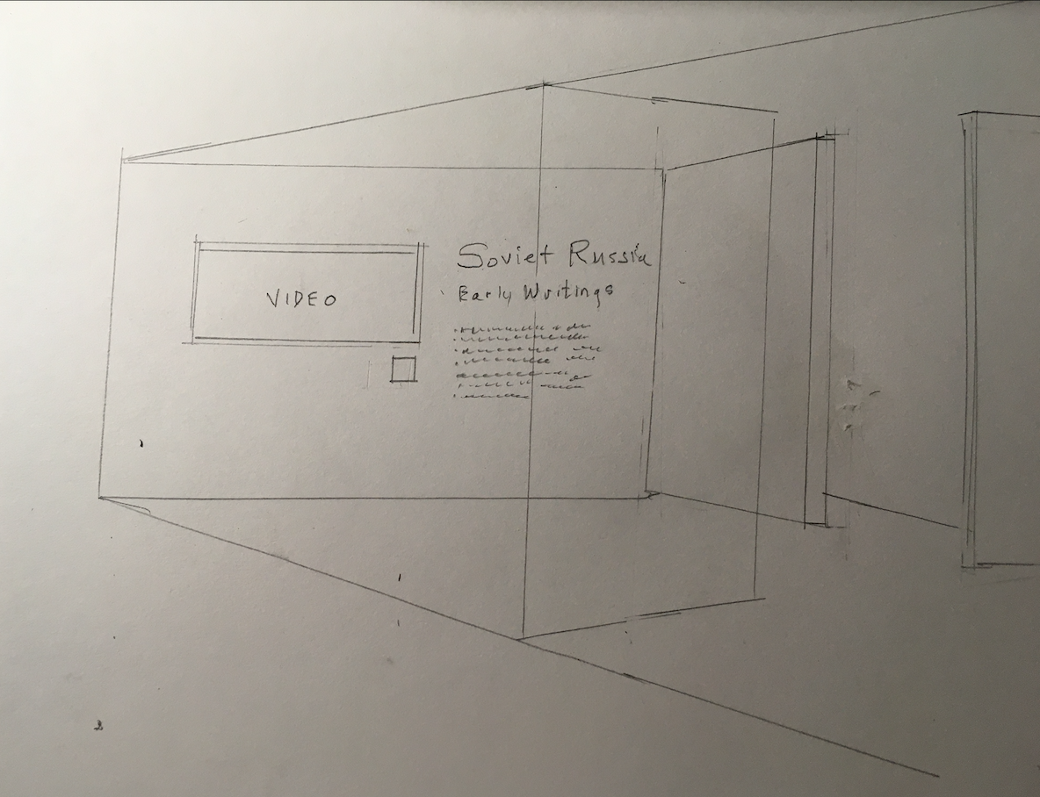
2. Russia
(As you enter, wall right)

Slide 12
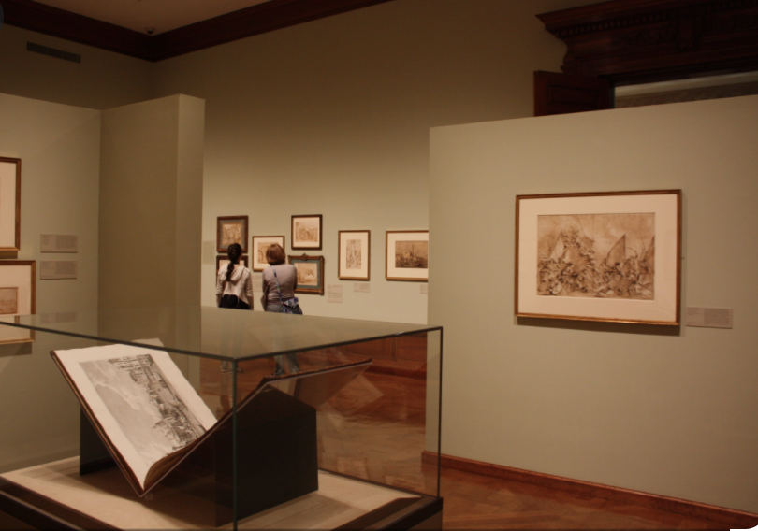
2. Russia: Colors & Suggested Lighting

Slide 13
2.1. Russia Focus Panel
[black lettering on light brown wall]
Soviet Russia
Early Writings
After completing her studies at the University of Leningrad in 1924, Ayn Rand enrolled at the State Technicum for Screen Arts, a film school established by Lenin for the development of Soviet cinema. Her objective was to study screenwriting, and in preparation she also began writing film reviews and short essays on Hollywood, some of which were published. She briefly thought about becoming a Soviet screenwriter, subtly incorporating her individualist ethical and political ideas into her scripts. But this early experiment with literary misdirection failed. The collectivist nature of Russian politics and culture was monolithic. And she realized her prospects for survival in Soviet Russia were nonexistent: “I would have been probably dead within one year,” she later concluded.

Slide 14
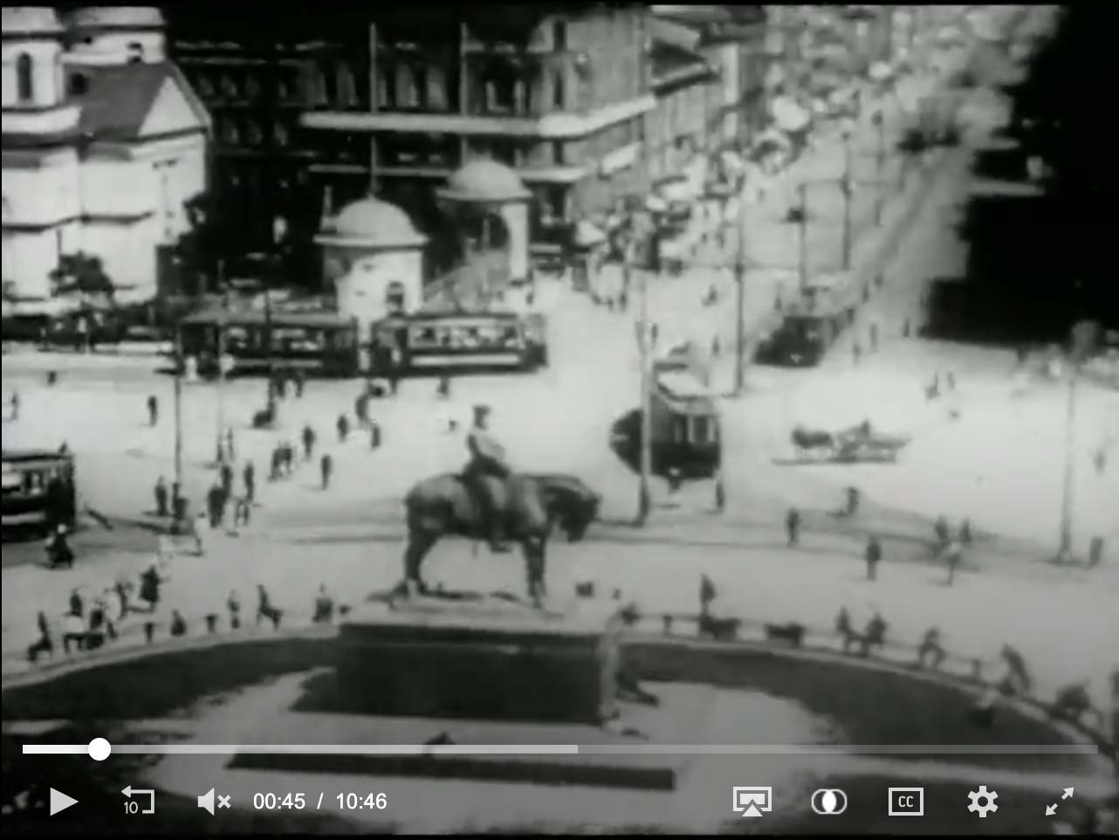
2.2. Video clip
https://archive.org/details/3177_Communism_02_10_39_20
Loop: 00:36 to 01:10

Slide 15
2.2.1. VIdeo Object Text Panel
[black lettering on off white square]
Leningrad, U.S.S.R.
This montage of film shots from Leningrad includes a long shot of the Square of the Uprising, which was taken from Ayn Rand’s family apartment building that housed her father’s commercial pharmacy. The business was nationalized during the Bolshevik Revolution.

Slide 16
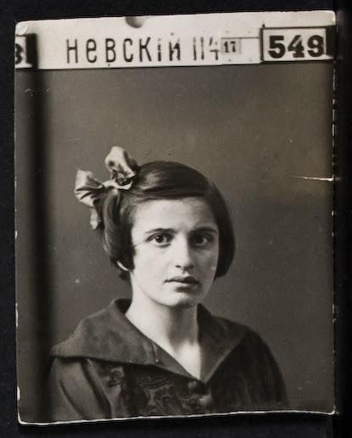
2.3. Ayn Rand: University ID

Slide 17
2.3 Text Panel
[black lettering on off white square]
Alisa Rosenbaum

Slide 46
Become an architect of the future by helping to build
the Ayn Rand Archives of the present
ari.aynrand.org/archivesfriends

